Slide 1
Presentation to Chief Academic Officers Mary I. Vanis, Ed.D. HLC Team Chair & Peer Reviewer Mary Vanis
AIHEC 40th Anniversary Conference

Slide 2
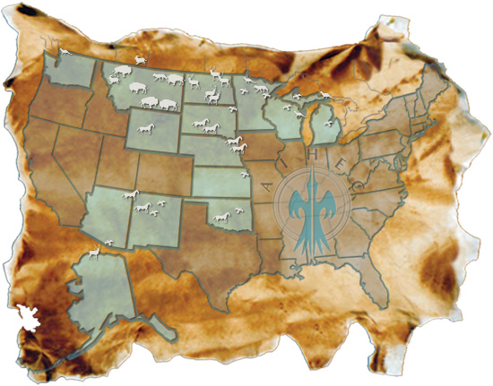
Considerations for Peer Reviewers
Distinctive and Connected:
Tribal Colleges and Universities and
HLC Accreditation

Slide 3
Tribal Colleges and Universities and HLC Accreditation
37 Tribal Colleges and Universities are serving more than 20,000 students
75% of the colleges are in the HLC Region

Slide 4
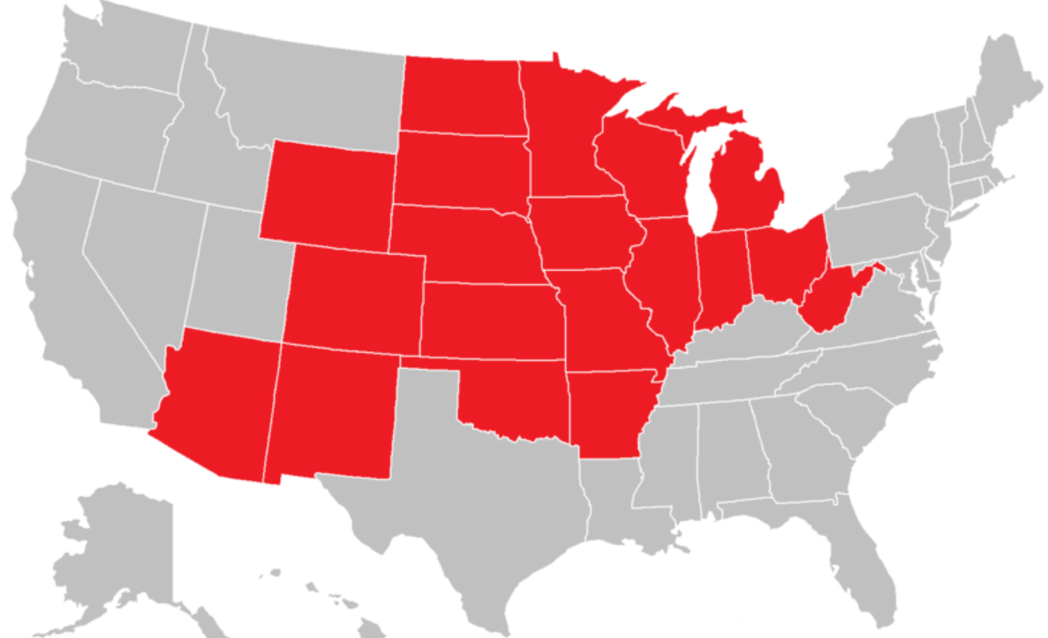
Importance of Tribal Colleges & Universities to the Higher Learning Commission
Map of the 19 HLC States
Map of TCUs in 11 HLC States

Slide 5
Project Background Distinctive and Connected: Tribal Colleges and Universities and HLC Accreditation
Directive of Dr. Sylvia Manning, HLC President
Collaborative Team: HLC Peer Reviewers, AIHEC Leadership, and HLC Liaisons
Reflects Unique Aspects of TCUs and Challenges with Accreditation requirements

Slide 6
Focus of Today’s Program
Share the Rationale and Purpose of the New Document
Review the Highlights of the Document
Discuss Challenges, Questions and Ideas on how to best use the document in HLC training of peer reviewers.

Slide 7
Tribal Colleges and Universities Defined
Criterion One: Mission

Slide 8
Understanding the Context Criterion One: Mission
Federal Definition
Balance of Multiple Roles of TCUs
Vision and Mission of TCUs
Culture and Traditions
Role of Elders
What is most important for a team to know about your college for your tribe and community ?

Slide 9
Federal Legislation and Tribal Commitment -- Governance
Criterion Two: Integrity – Ethical and Responsible Conduct

Slide 10
Understanding the Context Criterion Two: Integrity – Ethical and Responsible Conduct
Role of the Tribe & It’s Charter
Role of the Tribal Council
Role of the College Board of Trustees
College Leadership
As CAOs, what are your greatest challenges in working with the HLC Team and issues of leadership and Integrity?

Slide 11
Criterion Five: Resources, Planning and Institutional Effectiveness
Financial and Other Resources

Slide 12
Understanding the Context Criterion Five: Resources, Planning and Institutional Effectiveness
The Wide Range of Federal Funding Sources and Regulations
The Challenge of On-Going Fund Raising
Tribal Contributions
White House Executive Order
What actions should you take to prepare for the question about sustainability of programs, services and funding?

Slide 13
College Curriculum, Programs and Services to Students
Criterion Three: Teaching and Learning – Quality, Resources and Support
Criterion Four: Teaching and Learning – Evaluation and Improvement

Slide 14
Understanding the Context Criterion Three and Four: Teaching and Learning
Academic and Student Support Programs
Faculty and Staff
Preservation of Language and Culture
Assessment
This is the heart and soul of what you do as a CAO. What are your best hopes and worst fears in working with an HLC team?

Slide 15
Cultural Competencies/Awareness and Visit Logistics for HLC Peer Reviewers
Ceremonies and Customs
Role of the Team Chair
Communication
What are some ways you can assure a successful visit?

Slide 16
Electronic Links to Publication:
http://www.ncahlc.org
http://www.aihec.org/resources/reports.cfm
maryvanis@yahoo.com

Slide 17
THANK YOU!

